Slide 1









NAME: Mehta Dhruv Roll No: 84
Enrollment No: 2301031830020 Division:D3
Branch: CSE

Slide 2









Advanced NumPy Libraries

Slide 3




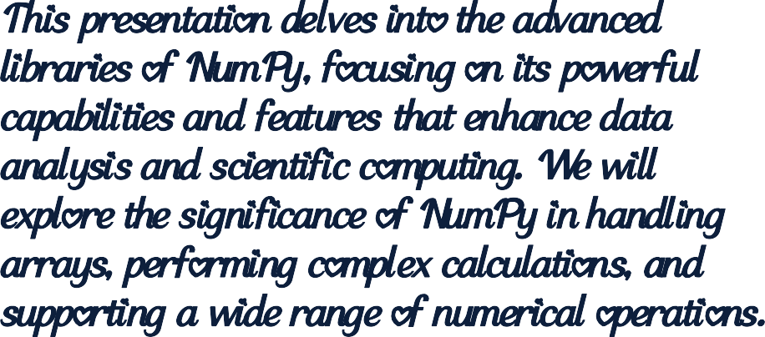




Introduction

Slide 4
01
Overview of NumPy

Slide 5


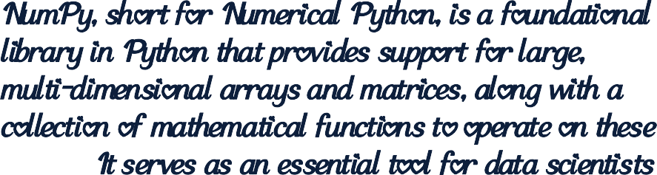

Introduction to NumPy

Slide 6



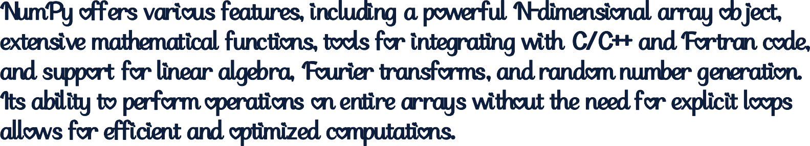





Core features and capabilities

Slide 7

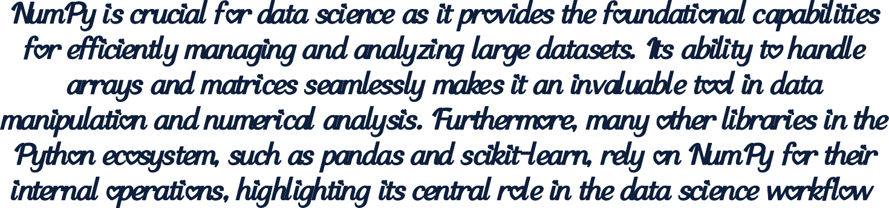
Importance in data science and programming
.

Slide 8
02
Advanced NumPy Functions

Slide 9

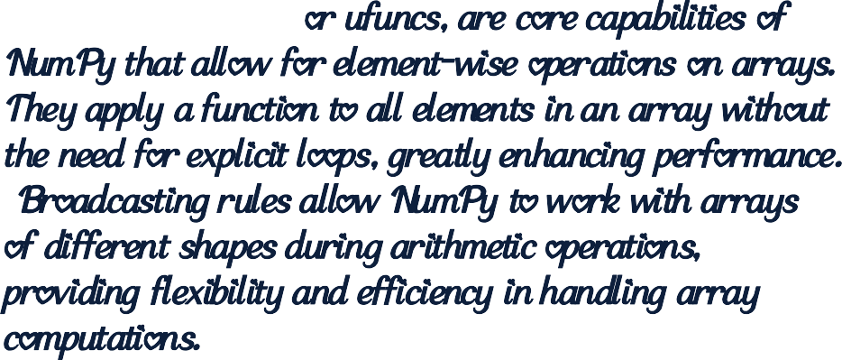

Universal functions and broadcasting

Slide 10
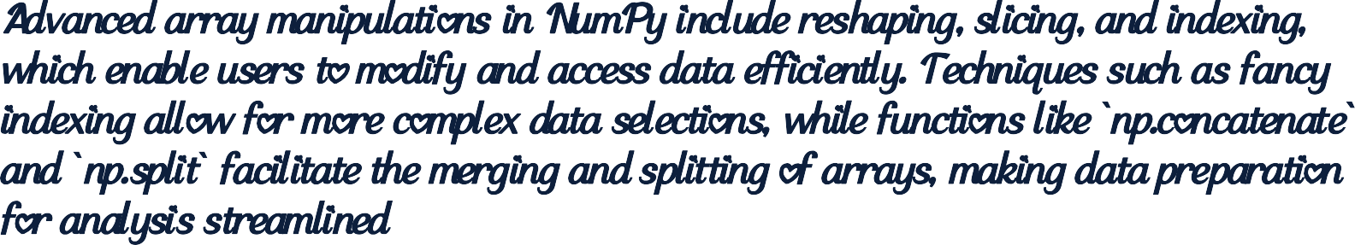
Advanced array manipulations
.

Slide 11
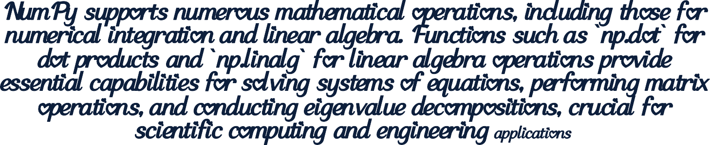
Numerical integration
and linear algebra
.

Slide 12







Conclusions
In summary, NumPy stands as a powerful library that significantly boosts productivity in data science and programming. Its advanced features allow for efficient data manipulation, complex numerical tasks, and seamless integration with the broader Python ecosystem, making it an indispensable tool for researchers and developers alike.

